Slide 1
Modeling Memory: A Deep Dive
Simon Gibson

Slide 2
What is Memory?
Memory is the capacity to preserve and recover information over time.
Memory serves as the basis for our judgement, reasoning, learning, and problem solving..
Memory is what prepares us for future experiences.
Our memories are in some aspect what makes us who we are (along with other factors).
There is no single type of memory. Instead, it is by consensus that there exist distinct memory systems.
At the highest level, they consist of Sensory, Short-Term or Working, and Long-Term memory.

Slide 3
Sensory Memory
Sensory memory is a representation of direct stimulus interacting with our senses.
Gone in the blink of an eye, sensory memory has a duration of under a second.
Conversely, sensory memory has a nearly unlimited capacity.
While not all sensory memory in translated into other forms of memory, the amount of information processed is incredible.
Memory that does not get attention resources decays.
You can remember only 5-6 letters in a 4x3 array usually, but with cueing to report after seeing array, participants easily reported all 12 letters. (14)

Slide 4
Working Memory
Working memory is a limited capacity system that can hold information temporarily.
Agreed upon capacity is 7 ± 2 objects.
Each object can be a meaningful group of other objects. This is referred to as a chunk.
Information can be stored in different formats (such as auditorily, visually, and spatially), where it eithers decays or enters a rehearsal loop.
During this loop, information that is given attention resources is constantly refreshed to prevent decay.
Working memory performs a serial search that is exhaustive. Recall time is related to the size of the set of objects memorized.
Short duration. Complete information decay in around 15 seconds. (15)
Capacity deteriorates quickly in early 20’s and then stagnates until 70’s where it quickly deteriorates again (17)

Slide 5
Long-Term Memory
Long-Term memory is self descriptive. It refers to the storage and retrieval of information along an extended period of time.
Long-Term memory tends to be stable.
Most long-term related memory loss occurs in the late 70’s. (17)
Divided into two groups: Procedural and Declarative memory.
Procedural memory covers all information that is procedural (such as skills, procedures, and conditioning).
Declarative is further split into two more groups: Semantic and Episodic memory
Semantic memory covers all knowledge related to facts or information.
Episodic memory covers the individuals' experiences
Long-Term memory is modified every time a memory is accessed (18)

Slide 6
Unanswered Questions
What is the relationship between types of memory?
How do they interrelate?
How can we model this relationship?
What causes memory loss?
Is it the same underlying processes for all types? Might a process such as consolidation have a different mode of memory loss than retrieval?
How is memory translated between STM, Working, and LTM?
Do individual processes for these types of memory even exist? Or is it all just one complex network?
What are the practical applications of these cognitive models and architectures?
How do we model symbolic procedures if our brain is purely connectionist?
How do we know how long it would take to perform mental addition? Can we predict emergent properties of neural networks?

Slide 7
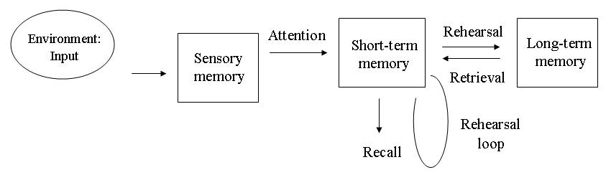
Memory Models – A review
Atkinson-Shiffrin – Multi-Store Model (1)
Three main stores of memory – Sensory, Short-Term, and Long-Term
An information processing model, with clear input, processing and output
Information enters sensory memory and if given attention passes to short-term memory
Once in STM, information undergoes a rehearsal loop until it is rehearsed into LTM or is lost
Memory is retrieved from LTM into STM and then recalled
Each memory store has differing capacity and duration
Too simple to explain many aspects of memory
Notes:
Before we touch upon memory/cognition models of current research and consensus, here is a review of the models presented in the course textbook and their strengths/weaknesses
Note – Graphic from Atkinson and Shiffrin 1968
Supported by Glanzer and Cunitz research which showed the serial position effect. The serial position effect strongly encourages a division in short-term and long-term memory.
Also Case study of KF – Motorcycle Crash. LTM unaffected but could only remember the last thing rehearsed from STM into LTM before crash.
Strengths –
Great basis for further expansion and research. Generated lots of interest into memory as a research field.
Weaknesses –
Assumes STM is static. Assumes LTM is a singular storage facility where all rehearsed information is stored
Rehearsal is too simple to describe transfer of STM into LTM. (recalling swimming without rehearsal, but not remembering notes for exam even with heavy rehearsal)

Slide 8
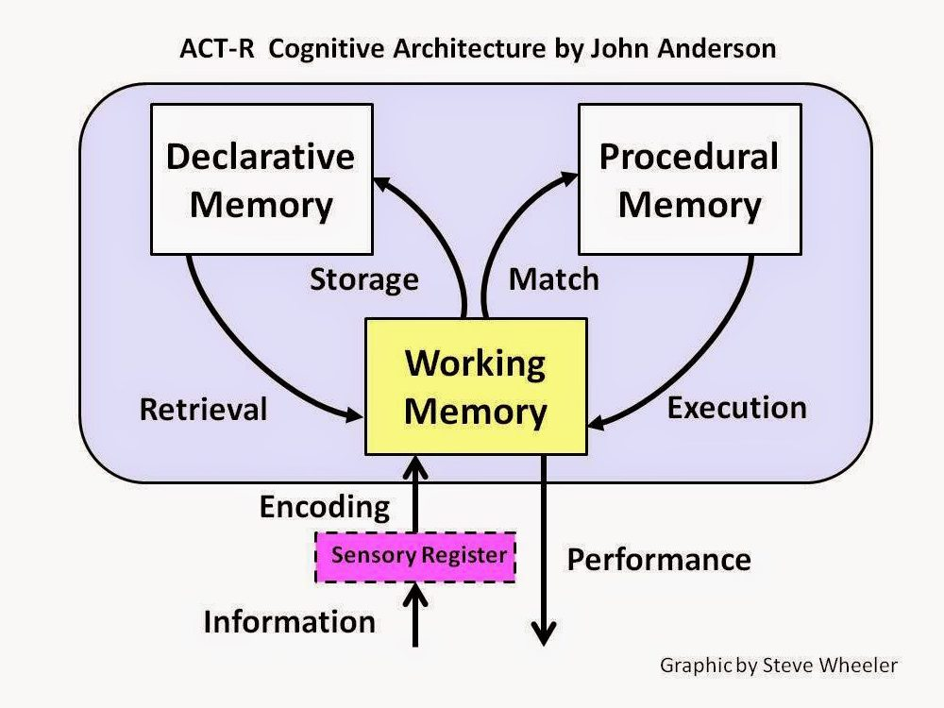
Memory Models – A review
Anderson – ACT* Model (1983, 1990) (2)
Expansion to Atkinson-Shiffrin model.
A cognitive architecture – A theory about the structure of the human mind, and a computational application to AI and neural networks
Three component system
working, declarative, and procedural memory
Separate processing loops for declarative and production memory.
Can be used in tandem with Baddeley’s Working Memory model
Re-envisioned as ACT-R in recent years
Notes:
Covered in Textbook: Atkinson-Shiffrin, ACT* (Computational Approach), Working Memory Model (Short Term memory),
ACT-R allows for a compromise between fully symbolic and connectionist approaches
From Wikipedia, citing creators of ACT-R “Members of the ACT-R community, including its developers, prefer to think of ACT-R as a general framework that specifies how the brain is organized, and how its organization gives birth to what is perceived (and, in cognitive psychology, investigated) as mind, going beyond the traditional symbolic/connectionist debate.”
ADAPTIVE CONTROL OF THOUGHT!!
Declarative – Facts about things – Explicit
Procedural – Knowledge of actions, such as driving home from work – Implicit
Explicit and Implicit memory are separate <- Known because conscious awareness accompanies explicit, and not implicit memory

Slide 9
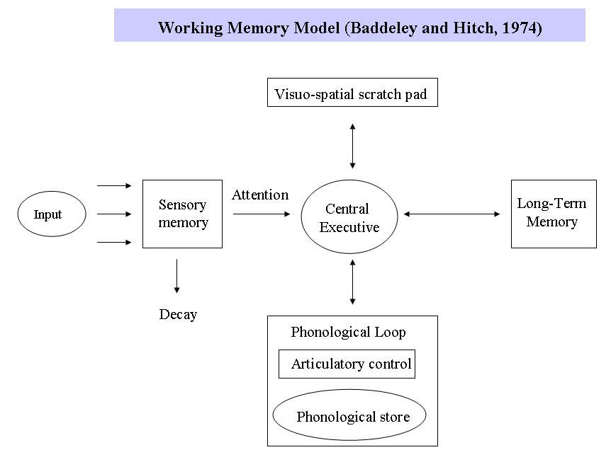
Memory Models – A review
Baddeley – Working Memory Model (1986) (3)
Executive control system that oversees Articulatory Loop and Visuospatial Sketchpad
Articulatory Loop and Visuospatial Sketchpad are slave systems. They are domain specific.
Each system has clearly defined roles and independent attention resources
Supported by regional analysis of brain during auditory versus visual functions
As opposed to the Multi-Store model, Working memory retains and processes information, as well as initiates different systems for types of information
Notes:
Covered in Textbook: Atkinson-Shiffrin, ACT* (Computational Approach), Working Memory Model (Short Term memory),
This model uproots the belief that working memory is rather static, instead has lots of work to do
Articulatory Loop – where speech and auditory information is rehearsed, held in limbo while executive system determines you should refresh the information
Visuospatial Sketchpad – Processing of visual information (e.g., tasks such as visual imagery or mental movement of an object)
Executive – Responsible for other processes such as reasoning and language
Each system has their own resources, but one failing causes a bottleneck. So, if AL has a lot of information to process, working memory suffers in its entirety
Note – Graphic from Baddeley and Hitch 1974 (4)
Strengths: Explains differences in short-term memory information processing areas (i.e., visual vs auditory information), allows connectionist descriptions in VS and AL
Weaknesses

Slide 10
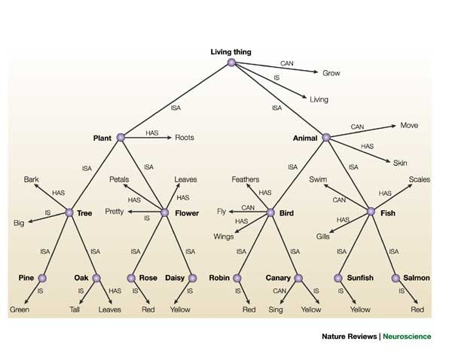
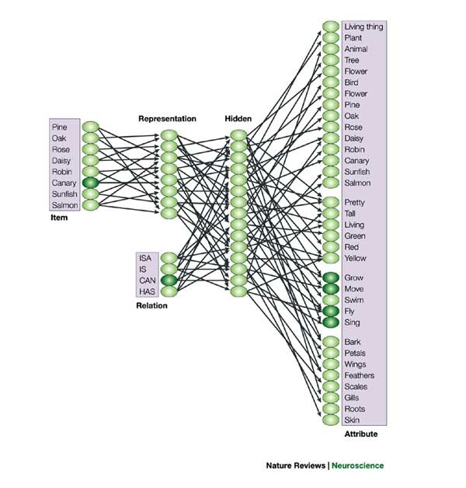
Memory Models – PDP
McClelland, Rogers – Parallel Distributed Processing (2003) (5)
First major approach to connectionist representations of memory and cognition (16)
Memory emerges not from the elements in the network, but from the connections themselves
Similar to a multi-layer neural network. The weight of connections determine the output
Incredibly effective at representing abstract groupings
For example, PDP gives a possible explanation into why a spread of objects naturally groups in our memory
PDP is a feedforward network. No backpropagation is possible
Offers explanations for miss-retrieval of similar objects (i.e., saying pear instead of peach)
Notes:
PDP Model – A product of the worldwide rise in machine learning and neural networks, return of connectionism
Strengths: The model provides a means of addressing some of the criticisms of these other theories. Specifically, it indicates how some properties of objects, including causal properties, come to be more important than other properties; why some groups of items seem to form natural or coherent categories; how domain-specific patterns of generalization and differentiation might arise
Weaknesses: Some of the relevant phenomena have yet to be addressed by PDP models, leaving this as a task for the future.
Semantic dementia is used to give inspiration for this model
Neural networks are fuzzy by nature, there is no clear symbolic ruleset. Connectionism allows for mistakes in cognition and memory retrieval.
Pictured to the right is a comparison between traditional symbolic classifications versus a PDP classification network for the same objects (Quillian’s Hierarchy)

Slide 11
Recent Research
Recurrent Neural Networks for Memory Modeling
An expansion on Parallel Distributed Processes. Recurrent Neural Networks better represent cognitive processes such as natural language processing, speech recognition, and language translation. (6)
These networks have no clear propagation direction. Thus, “the activity of neurons in the network is affected not only by the current stimulus, but also by the current state of the network.” (7)
Representative of mental states. Decision making is heavily influenced by your emotions and current mental state. The degree of effect that your emotions cause changes temporally with your emotions. (9)
RNN’s are excellent at representing computations that are temporal in nature. This is ideal, as decision making and working memory are not static, but ever-changing processes. (3)
Notes:
alternative framework to model neural systems that holds much promise
Bullet 1: These networks are very novel; with corporate implementation such as google voice recognition using LSTM from the past 5 years
Bullet 2:

Slide 12
Recent Research
Recurrent Neural Networks for Memory Modeling (cont.)
RNN’s can describe proactive and retroactive interference. Recurrence in the network when a new memory is processed may “overwrite” or strengthen previous memories.
Memory loss can be the result of overwritten connections due to recurrence or relatively unused connections.
“The nature of an individual's past experience with an object strongly determines the brain circuitry involved in representing that object's multisensory features in memory.” (8)
A difference between computational networks and neurons themselves arises in their connections. While RNN’s have a continuous domain, “neurons, however, communicate primarily through discontinuous spiking.” (10)
RNN’s have taken mainstage in research; however, Spiking Neural Networks are receiving ever increasing attention as memory and cognitive models.
As of 2019 SNNs lag behind ANNs in terms of accuracy, but the gap is decreasing, and has vanished on some tasks. (11)
Notes:
alternative framework to model neural systems that holds much promise

Slide 13
Recent Research
RNN’s are not the final answer.
They are not predesigned for a specified problem, making it difficult to train these networks.
SNN’s benefit from increased computational power per neuron, as well as less overall network complexity. (12)
It has been shown that neural networks with “oscillating feedback inhibition in the presence of noise” create a change of state of memory representations. (13)
This allows us to predict the time it takes to recall a memory with respect to the number of neural connections that represent the memory.
Notes:
As an example of predicting emergent properties …. It has been shown

Slide 14
Discussion
Most modern research into cognitive modeling has forsaken symbolic and hierarchical structures in favor of connectionist approaches.
Symbolic models of memory unlock key insights and can represent findings better than a neural network.
However, they lack a wholistic view on memory; often failing to account for or explain various mental phenomena.
Artificial Neural Networks, which derive inspiration from the brain itself, succeed in capturing the emergent properties of memory.
By nature, ANN’s are hard to predict. Nevertheless, so is human behavior and decision making. Additionally, we cannot yet model some symbolic procedures with neural networks (such as addition).
Recent advancements in cognitive modeling are bringing us closer to accurately predicting emergent properties.
Notes:
Why return connectionist approaches now? The first perceptron was in the 1940’s. There has only been 80 years of development in this field. Before computers, the calculations were not feasible. Due to Moore’s Law, computational power has skyrocketed over the past. We can model more and more systems.
Symbolic models have their purpose. AI’s such as first order logic systems on computers can solve almost every symbolic problem. These types of models are simple and easy to understand. Easy to organize findings in a type of chart than as a network of seemingly meaningless data. Can only represent what they are defined to represent, while ANN can represent a swath of biological processes at once.
ANN’s are emergent, can't just add up all components and get the answer. Gestalt blah blah blah. However, some properties of neural networks are being decoded, such as predicting

Slide 15
Applications
Cognitive modeling has numerous unique applications in industry. With the advent of smart devices, fields such as natural language processing (NLP), voice recognition, and image captioning have become the pinnacle of cognitive research.
While these systems are initially designed for industry use, research in this field is ripe with insights into mental processes and depictions of the mind.
Just as weapons development during the second World War spurred technological advancements in leaps and bounds, corporate investment into cognitive modeling may further understanding of the human mind at an explosive rate.

Slide 16
Sources Cited
Modal - Atkinson, R. C., & Shiffrin, R. M. (1968). Chapter: Human memory: A proposed system and its control processes. In Spence, K. W., & Spence, J. T. The psychology of learning and motivation (Volume 2). New York: Academic Press. pp. 89–195.
Anderson, J. R. (1983). The architecture of cognition. Cambridge, MA: Harvard University Press.
Baddeley, A. D. (1986). Working Memory. Oxford: Oxford University Press.
Baddeley, A. D., & Hitch, G. J. (1974). Working memory. In G. A. Bower (Ed.), The psychology of learning and motivation: Advances in research and theory. (Vol. 8, pp. 47-89). New York: Academic Press.
McClelland, J., Rogers, T. The parallel distributed processing approach to semantic cognition. Nat Rev Neurosci 4, 310–322 (2003). https://doi.org/10.1038/nrn1076
Li, Xiangang; Wu, Xihong (2014-10-15). "Constructing Long Short-Term Memory based Deep Recurrent Neural Networks for Large Vocabulary Speech Recognition". arXiv:1410.4281 [cs.CL].
Barak, Omri. “Recurrent Neural Networks as Versatile Tools of Neuroscience Research.” Current Opinion in Neurobiology, Elsevier Current Trends, 29 June 2017, https://www.sciencedirect.com/science/article/pii/S0959438817300429#bib0615.
Jacklin, Derek L., et al. “The Dynamic Multisensory Engram: Neural Circuitry Underlying Crossmodal Object Recognition in Rats Changes with the Nature of Object Experience.” Journal of Neuroscience, Society for Neuroscience, 27 Jan. 2016, https://www.jneurosci.org/content/36/4/1273.
Lerner, Jennifer S. “Emotion and Decision Making.” Annual Reviews, Annual Review of Psychology, Jan. 2015, https://www.annualreviews.org/doi/10.1146/annurev-psych-010213-115043.
Abbott, L., DePasquale, B. & Memmesheimer, RM. Building functional networks of spiking model neurons. Nat Neurosci 19, 350–355 (2016). https://doi.org/10.1038/nn.4241

Slide 17
Sources Cited
Tavanaei, Amirhossein; Ghodrati, Masoud; Kheradpisheh, Saeed Reza; Masquelier, Timothée; Maida, Anthony (March 2019). "Deep learning in spiking neural networks". Neural Networks. 111: 47–63. arXiv:1804.08150. doi:10.1016/j.neunet.2018.12.002. PMID 30682710. S2CID 5039751.
Maass, Wolfgang (1997). "Networks of spiking neurons: The third generation of neural network models". Neural Networks. 10 (9): 1659–1671. doi:10.1016/S0893-6080(97)00011-7.
Recanatesi, Stefano, et al. “Neural Network Model of Memory Retrieval.” Frontiers, Frontiers In Computational Neurosicence, 1 Jan. 1AD, https://www.frontiersin.org/articles/10.3389/fncom.2015.00149/full.
Sperling G. A Model for Visual Memory Tasks. Human Factors. 1963;5(1):19-31. doi:10.1177/001872086300500103
E. Bruce Goldstein. Cognitive Psychology: Connecting Mind, Research and Everyday Experience. Wadsworth Publishing, 2010
Mcclelland, James L. Parallel Distributed Processing: Explorations in the Microstructure of Cognition: Foundations. Mit Press, 1986.
Buckner, Randy L. “Memory and Executive Function in Aging and AD: Multiple Factors That Cause Decline and Reserve Factors That Compensate.” Neuron, Cell Press, 29 Sept. 2004, https://www.sciencedirect.com/science/article/pii/S0896627304005811.
Camina E, Güell F. The neuroanatomical, neurophysiological and psychological basis of memory: current models and their origins. Front Pharmacol. 2017;8:438. doi:10.3389/fphar.2017.00438

